Slide 1
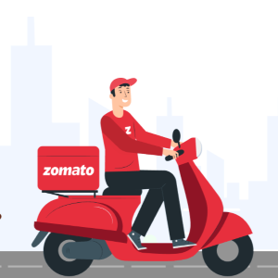
ZOMATO RESTAURANTS GROWTH INSIGHTS
-A STRATEGIC ANALYSIS
BY SAURABH SHARMA

Slide 2
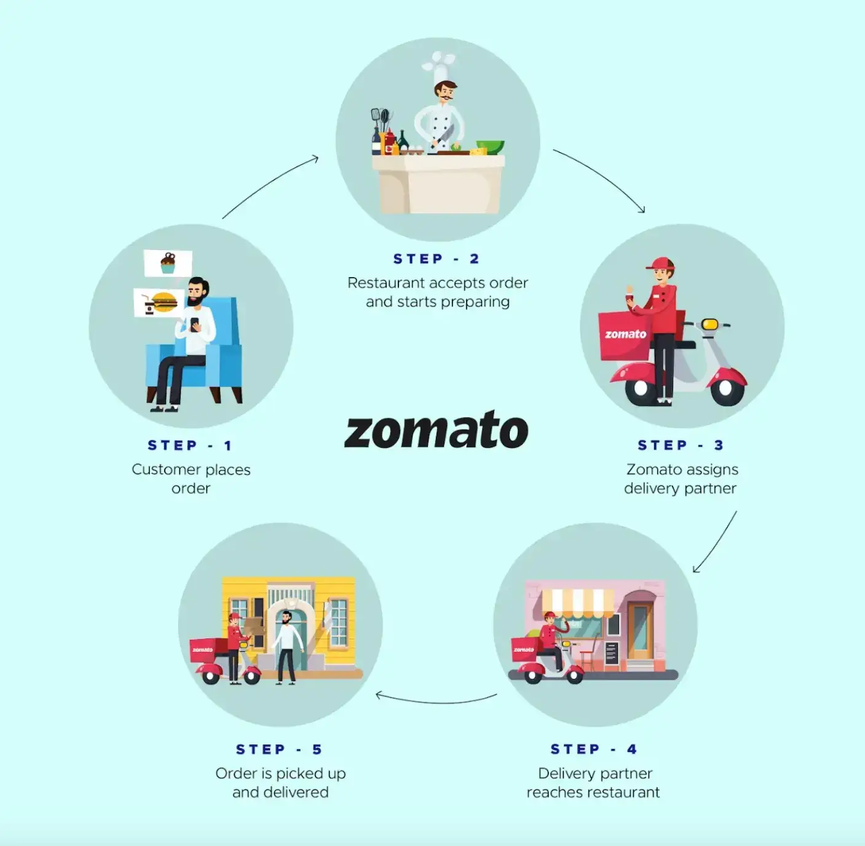
HOW IT WORKS
Step 1 – Customer Places Order
Step 2 – Restaurant Accepts & Prepares Order
Step 3 – Zomato Assigns Delivery Partner
Step 4 – Delivery Partner Reaches Restaurant
Step 5 – Order Picked Up & Delivered

Slide 3
AGENDA
1.PROBLEM STATEMENT
2.OBJECTIVE OF PROJECT
3.DATA OVERVIEW
4.METHODOLOGY
5.ANALYTICAL INSIGHTS
6.DASHBOARD
7.EFFECTIVE RECOMMENDATIONS
8.FINAL OUTCOMES

Slide 4
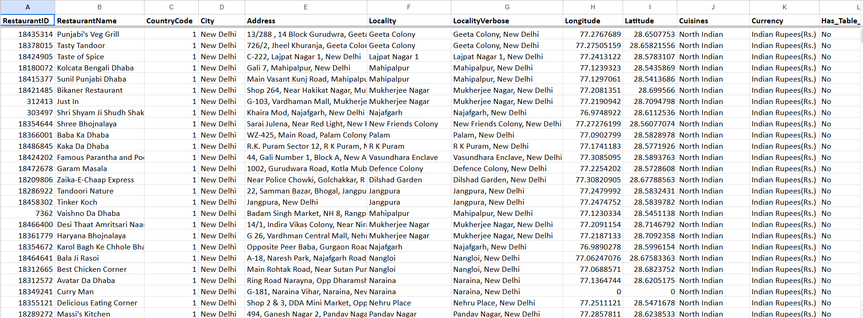
PROBLEM STATEMENT

Slide 5
OBJECTIVE OF PROJECT
The objective of this project is to analyze Zomato’s restaurant data to identify potential countries and cities for business expansion using data-driven insights.
The project focuses on understanding market trends, customer preferences, pricing behavior, and service adoption to provide actionable recommendations for strategic restaurant openings.
Sub-objectives:
To determine countries with high growth potential and low competition.
To analyze customer ratings, votes, and cuisines for better decision-making.
To evaluate the impact of services like online delivery and table booking on customer satisfaction.
To identify profitable pricing patterns and compare cost vs rating.
To develop a data-driven strategy for Zomato’s global market expansion.

Slide 6
DATA OVERVIEW
Dataset Summary
Contains 9,551 restaurant records across 15+ countries.
Covers data from India, USA, UK, Canada, Qatar, Singapore, etc.
Includes 24 key attributes for analysis.
Key Columns
Restaurant Details: Name, ID, City, Country
Customer Insights: Ratings, Votes, Cuisines
Financial Metrics: Price Range, Average Cost for Two
Service Indicators: Online Delivery, Table Booking
Geographical Data: Latitude, Longitude for mapping
Key Insights from Data
India dominates with 8,652 restaurants, indicating market saturation.
Other countries (like Canada, Qatar, Singapore) show low competition, ideal for expansion.
The dataset enables analysis of customer behavior, pricing, and performance trends.

Slide 7
METHODOLOGY
Data Cleaning & Preprocessing:
Removed duplicate records
Handled missing values in cost, votes, ratings
Standardized country/city names and service fields (Online Delivery, Table Booking)
Converted average cost into numeric values for analysis
Techniques:
Created Pivot Tables for country, city, cost, votes, and cuisines .
Designed charts (bar, line, pie) to visualize trends
Dashboard Creation :
Built interactive dashboard in Google Sheets with slicers for Year & Country.
Insight Generation:
Identified saturated vs. opportunity markets Correlated services (online delivery, table booking) with ratings.

Slide 8
Analytical Insights
1.RESTAURANTS OPENED EACH YEAR
2.RESTAURANTS OPENED IN DIFFERENT COUNTRIES
3.AVERAGE NO. OF VOTES IN EACH COUNTRIES
4.SUGGESTED COUNTRIES TO OPEN RESTAURANTS
5.EXPENDITURE ON FOOD
6.TOP 10 CUISINES IN SUGGESTED COUNTRIES
7. ANALYSIS OF ONLINE DELIVERY AND TABLE BOOKING
8. RATING AND COUNT OF SUGGESTED COUNTRIES
9. ANALYSIS OF PRICE RANGE

Slide 9
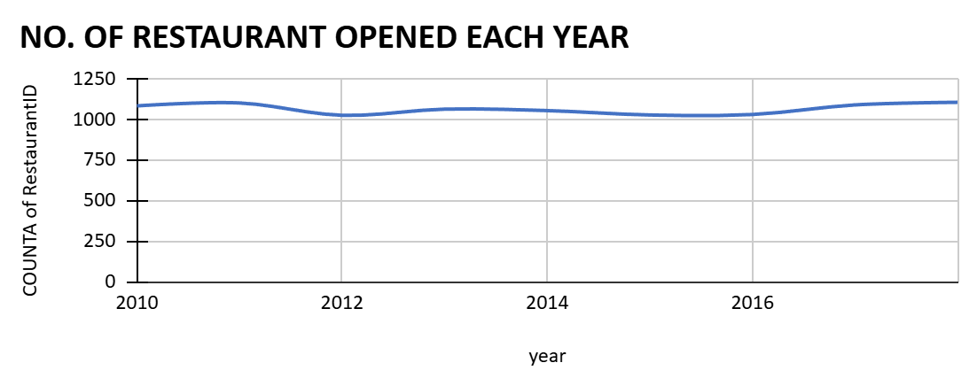
RESTAURANTS OPENED EACH YEAR
From 2010–2018, around 1,000 restaurants opened each year.
Lowest in 2012 (1,022) and highest in 2018 (1,102).
Indicates steady and consistent growth in Zomato’s expansion

Slide 10
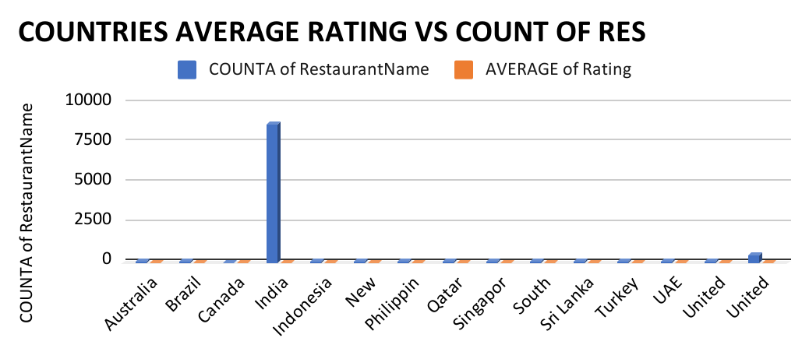
RESTAURANTS OPENED IN DIFFERENT COUNTRIES
India dominates with 8,652 restaurants, showing a saturated market.
Canada (4), Qatar (20), and Singapore (20) have low competition.
These countries offer strong potential for new restaurant expansion.

Slide 11
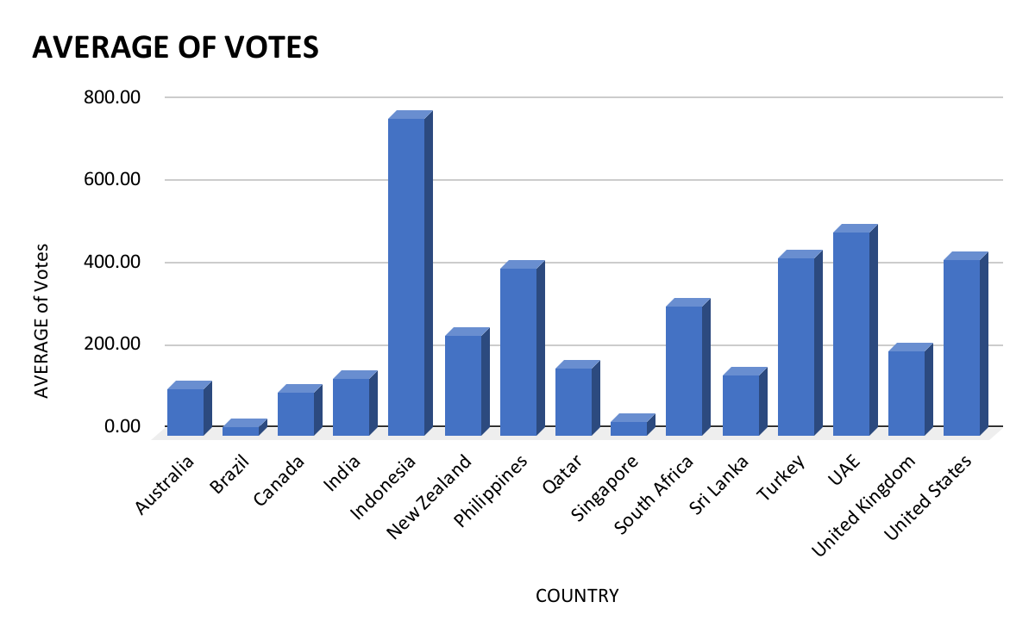
AVERAGE NO. OF VOTES IN EACH COUNTRY
Indonesia leads with the highest customer engagement — 772 votes per restaurant.
UAE (493) and USA (428) also show strong digital interaction.
India (137) and Canada (103) have low online engagement levels.
Indicates that customer participation is stronger in Indonesia, UAE, and the US compared to India and Canada.

Slide 12
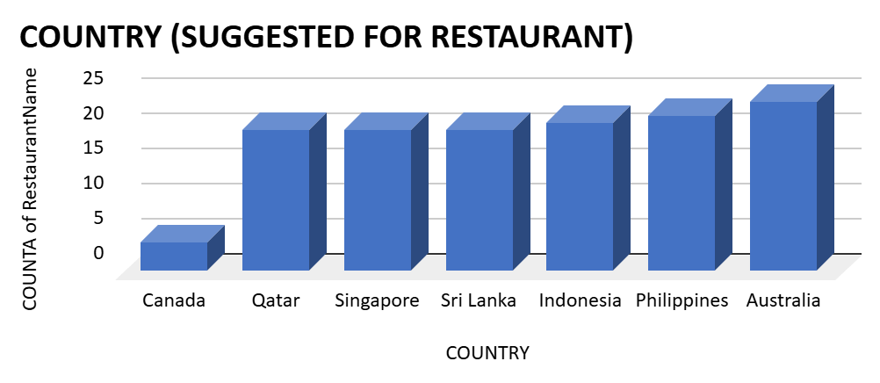
SUGGESTED COUNTRIES TO OPEN RESTAURANTS
Canada (4 restaurants) – lowest competition, best market for expansion.
Qatar (20 restaurants, average rating 4.06) – offers premium growth opportunities.
Singapore (20 restaurants) – shows moderate potential with steady demand.
India is oversaturated, while these countries offer untapped market potential.

Slide 13
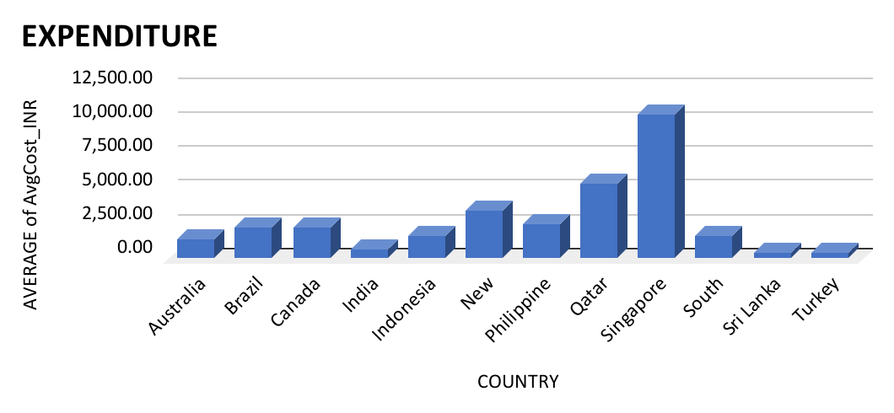
EXPENDITURE ON FOOD
Singapore shows the highest food expenditure (~₹2.6 lakh), indicating a premium market.
India, Brazil, Sri Lanka, and Canada have lower spending, showing budget-friendly markets.
The spending gap highlights lifestyle and income differences across countries.
High-spending countries offer better scope for premium restaurant expansion.

Slide 14
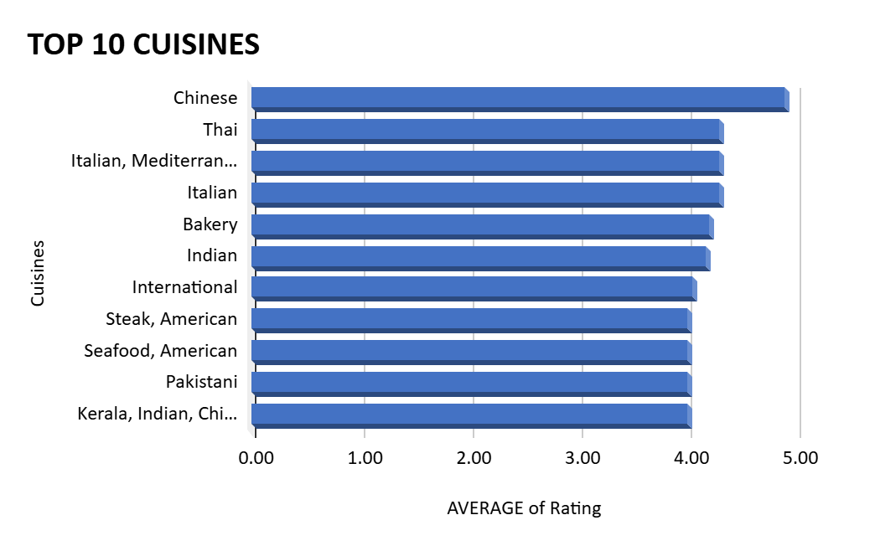
TOP 10 CUISINES IN SUGGESTED COUNTRIES
The top 10 cuisines in suggested countries (Canada, Qatar, Singapore) show strong customer preference for Chinese, Thai, Mughlai, Italian, and Bakery dishes.
These cuisines consistently maintain high average ratings (above 4.5), reflecting excellent customer satisfaction.
Western-Asian and some American cuisines received lower ratings (<3.5), indicating limited appeal.
Focusing on top-rated cuisines can help new restaurants attract customers and ensure success in competitive markets.

Slide 15
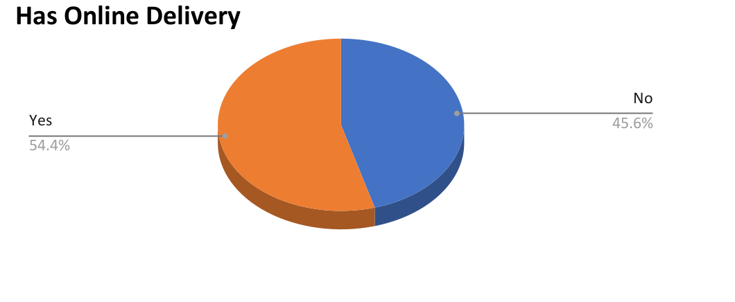
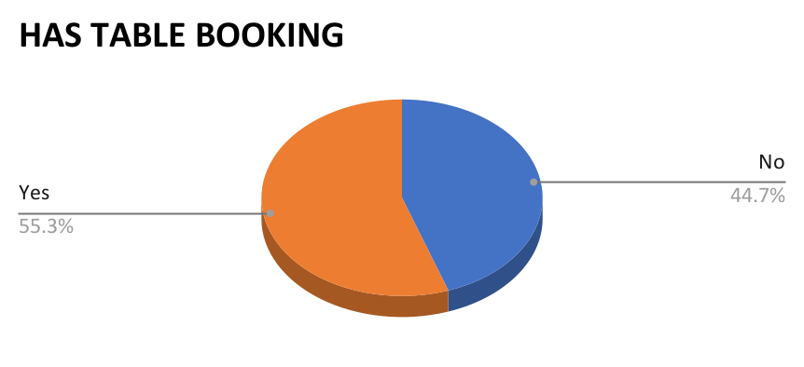
ANALYSIS OF ONLINE DELIVERY AND TABLE BOOKING
Online delivery restaurants had 54.4% positive ratings, showing high demand for convenience.
Table booking services received 55.3% positive ratings, reflecting preference for premium dining,
Both services strongly enhance customer satisfaction and engagement.
New restaurants should adopt online delivery and booking options to improve ratings and attract customers.

Slide 16
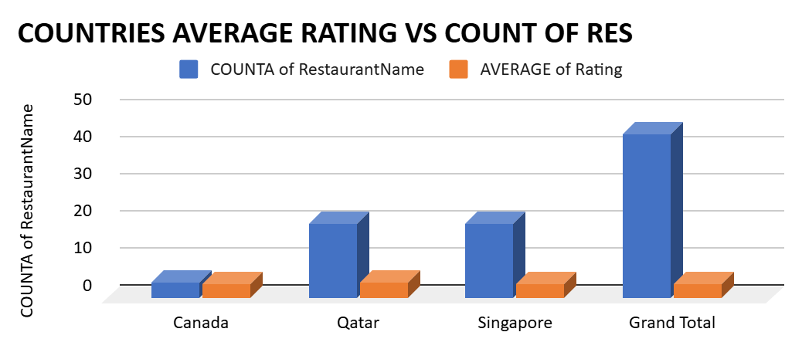
RATING AND COUNT OF SUGGESTED COUNTRIES
Canada – Only 4 restaurants with high potential due to low competition.
Qatar – Around 20 restaurants with an average rating of 4.06, showing premium market quality.
Singapore – Also 20 restaurants, offering moderate growth and balanced ratings.
These countries combine low restaurant count with strong ratings, making them ideal for Zomato’s expansion.

Slide 17
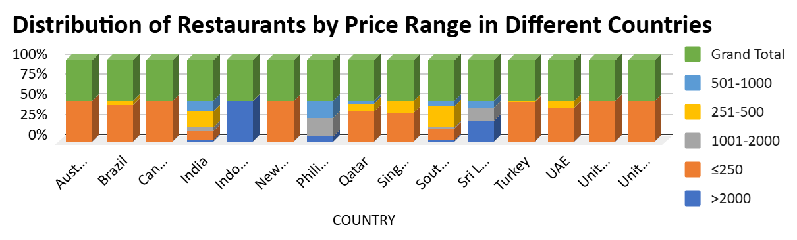
ANALYSIS OF PRICE RANGE
Most countries have maximum restaurants in the lowest price range (≤₹250), showing a focus on budget-friendly dining.
As the price range increases, the number of restaurants decreases sharply.
High-price categories (>₹1000) are limited, indicating premium restaurants are fewer but profitable.
Overall, the chart reflects that affordable dining dominates globally, while luxury dining remains niche.

Slide 18
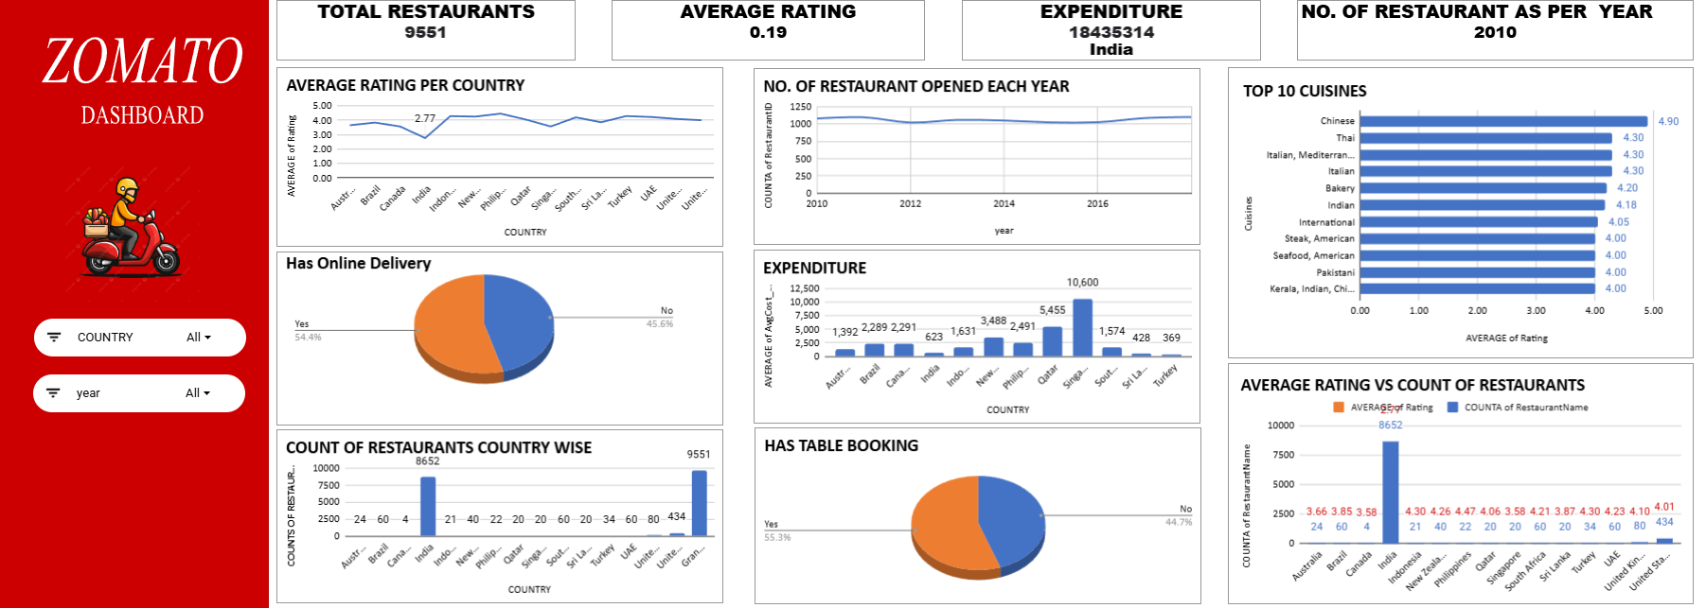
DASHBOARD

Slide 19
Effective Recommendations
Focus on expanding in countries with low competition and high growth potential like Canada, Qatar, and Singapore.
Introduce both Online Delivery and Table Booking services — these features strongly improve customer ratings and engagement.
Promote top-rated cuisines such as Chinese, Mughlai, Thai, Italian, and Bakery to attract diverse customer groups.
Adopt data-driven pricing strategies — maintain affordability in markets like India while offering premium options in countries like Qatar and Singapore.
Enhance digital engagement through customer feedback, loyalty rewards, and active participation to strengthen brand trust.
Use clean data analytics dashboards for continuous tracking of restaurant performance and customer satisfaction.

Slide 20
Final Outcomes
Identified top potential countries for Zomato’s expansion — Canada, Qatar, and Singapore, offering low competition and strong market potential.
Determined top-performing cuisines like Chinese, Mughlai, Thai, Italian, and Bakery, ideal for attracting high ratings and customer loyalty.
Found that Online Delivery and Table Booking services have a positive impact on customer satisfaction and ratings.
Analysis proved that price range has minimal effect on ratings, showing that service quality and cuisine choice matter more.
Data insights help Zomato plan strategic market entry and optimize restaurant openings for higher profitability.

Slide 21
THANK YOU

